Slide 1
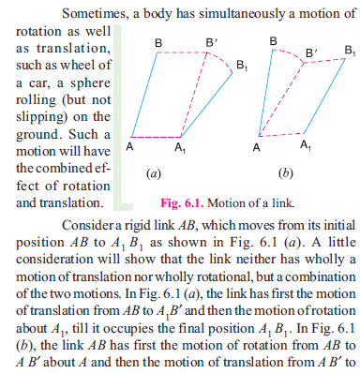
Theory of machines Wessam Al Azzawi
Mechanism:

Slide 2
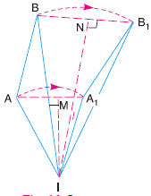
Theory of machines Wessam Al Azzawi
Mechanism:
A1 B1. Such a motion of link AB to A1 B1 is an example of combined motion of rotation and translation, it being immaterial whether the motion of rotation takes first, or the motion of translation.
This combined of motion of the link AB may be assumed to be a motion of pure rotation about some center I, known as the instantaneous center of rotation.
The instantaneous center of a moving goes on changing from one instant to another.
The locus of all instantaneous centers is known as centrode

Slide 3
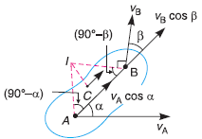
Theory of machines Wessam Al Azzawi
Mechanism:
Methods for Determining the Velocity of a Point on a Link:
Instantaneous center method
Relative velocity method
Instantaneous center method
Consider two points A and B on a rigid link. Let v_{A} and v_{B} be the velocities of points A and B, whose directions are given by angles α and β as shown in Fig.
If v_{A} is known in magnitude and direction and v_{B} in direction only, then the magnitude of v_{B} may be determined by the instantaneous center method as discussed below :
Draw AI and BI perpendiculars to the directions v_{A} and v_{B} respectively.

Slide 4
Theory of machines Wessam Al Azzawi
Mechanism:
Let these lines intersect at I
Since A and B are the points on a rigid link, therefore there cannot be any relative motion between them along the line AB

Slide 5
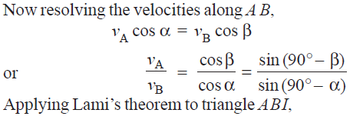
Theory of machines Wessam Al Azzawi
Mechanism:

Slide 6
Theory of machines Wessam Al Azzawi
Mechanism:
If v_{A} is known in magnitude and direction and v_{B} in direction only, then velocity of point B or any other point C on the link can be determined in magnitude and direction.
The magnitude of velocities of the points on a rigid link is inversely proportional to the distances from the points to the instantaneous center and is perpendicular to the line joining the point to the instantaneous center.

Slide 7
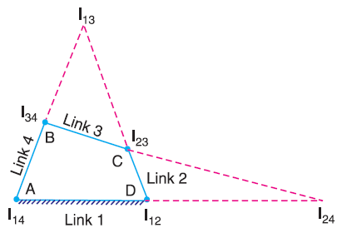
Theory of machines Wessam Al Azzawi
Mechanism:
Number of Instantaneous Centres in a Mechanism
The number of instantaneous centers is equal to the number of possible combinations of two links. Mathematically, number of instantaneous centers is:
The instantaneous centers I₁₂ and I₁₄ are fixed instantaneous centers as they remain in the same place for all configurations.
I₂₃ and I₃₄ are permanent instantaneous centers as they move when the mechanism moves.
I₁₃ and I₂₄ are neither fixed nor permanent instantaneous centers as they vary with the configuration of the mechanism

Slide 8
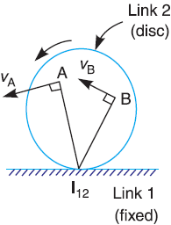
Theory of machines Wessam Al Azzawi
Mechanism:
Location of Instantaneous Centers
When the two links are connected by a pin, the instantaneous center on the center of the pin.
When links have a pure rolling contact (i.e. link 2 rolls without slipping upon the fixed link 1 which may be straight or curved), the instantaneous center lies on their point of contact. The velocity of any point A on the link 2 relative to fixed link 1 will be perpendicular to I₁₂ A and is proportional to I₁₂ A . In other words

Slide 9
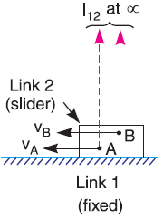
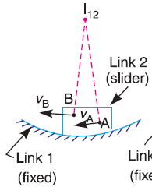
Theory of machines Wessam Al Azzawi
Mechanism:
Location of Instantaneous Centers
When the two links have a sliding contact, the instantaneous center lies on the common normal at the point of contact.
When fixed link 1 having straight surface, the instantaneous center lies at infinity and each point on the slider have the same velocity
When fixed link 1 having curved surface, the instantaneous center lies on the center of curvature.

Slide 10
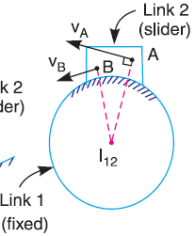
Theory of machines Wessam Al Azzawi
Mechanism:
Location of Instantaneous Centers
When the fixed link 1 having constant radius of curvature, the instantaneous center lies at the center of the circle.

Slide 11
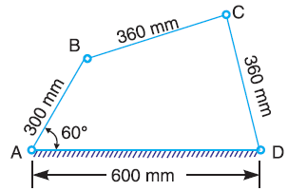
Theory of machines Wessam Al Azzawi
Mechanism:
Example. In a pin jointed four bar mechanism, as shown in Fig. 6.9, AB = 300 mm, BC = CD = 360 mm, and AD = 600 mm. The angle BAD = 60°. The crank AB rotates uniformly at 100 r.p.m. Locate all the instantaneous centers and find the angular velocity of the link BC.
Locate the fixed and permanent instantaneous centers I₁₂, I₂₃, I₃₄ and I₁₄, as shown in Fig

Slide 12
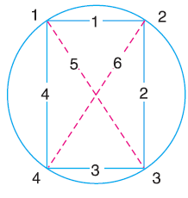
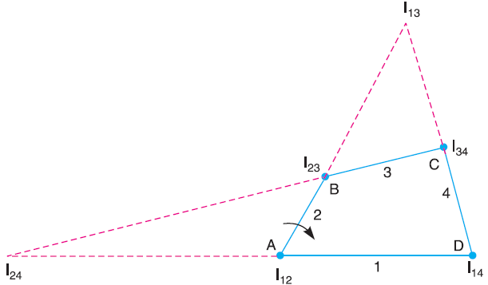
Theory of machines Wessam Al Azzawi
Mechanism:
Locate the remaining neither fixed nor permanent instantaneous centers. This is done by circle.
Mark four points (equal to the number of links in a mechanism) 1, 2, 3, and 4 on the circle.
Join points 1 to 2, 2 to 3, 3 to 4 and 4 to 1 to indicate the instantaneous centers already located i.e. I₁₂, I₂₃, I₃₄ and I₁₄.
Join 1 to 3 to form two triangles, side 13 common to both triangles. The instantaneous center I₁₃ lies on the intersection of the lines joining the points I₁₂ I₂₃ and I₃₄ I₁₄. Thus center I₁₃ is located.

Slide 13
Theory of machines Wessam Al Azzawi
Mechanism:
join 2 to 4 to complete two triangles 2 3 4 and 1 2 4. Therefore center I₂₄ lies on the intersection of the lines I₂₃ I₃₄ and I₁₂ I₁₄ thus center I₂₄ is located.

Slide 14
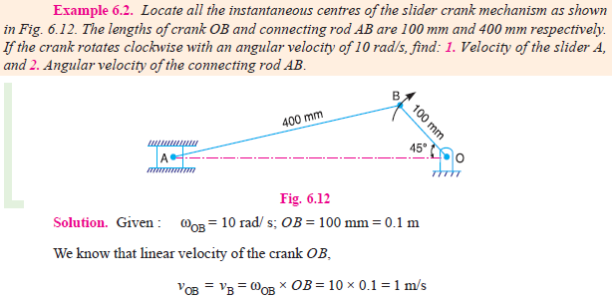
Theory of machines Wessam Al Azzawi
Mechanism:

Slide 15
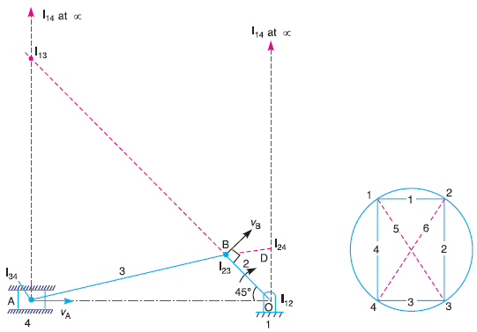
Theory of machines Wessam Al Azzawi
Mechanism:
Fixed and permanent instantaneous centers are I₁₂, I₂₃ and I₃₄ as shown in Fig

Slide 16
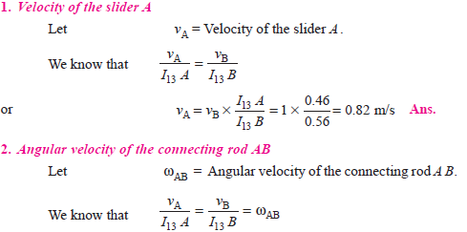
Theory of machines Wessam Al Azzawi
Mechanism:
Centre I₁₃ will lie on the intersection of I₁₂ I₂₃ and I₁₄ I₃₄, produced if necessary. Thus centre I₁₃ is located. Join 1 to 3 by a dotted line and mark number 5 on it
Centre I₂₄ lies on the intersection of I₂₃ I₃₄ and I₁₂ I₁₄. Join 2 to 4 by a dotted line on the circle diagram and mark number 6 on it.

Slide 17
Theory of machines Wessam Al Azzawi
Mechanism:

Slide 18
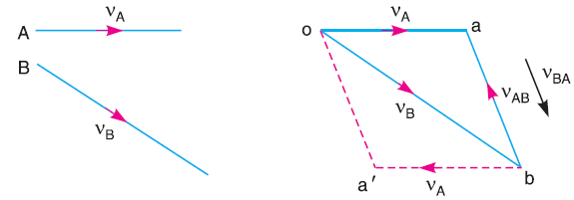
Theory of machines Wessam Al Azzawi
Mechanism:
Relative Velocity Method
Then vector ba represents the relative velocity of A with respect to B
Similarly, the relative velocity of B with respect to A,

Slide 19
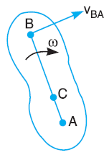
Theory of machines Wessam Al Azzawi
Mechanism:
From above, we conclude that the relative velocity of point A with respect to B (v_{AB}) and the relative velocity of point B with respect A (v_{BA}) are equal in magnitude but opposite in direction, i.e.
Motion of a Link
velocity of any point on a link with respect to another point on the same link is always perpendicular to the line joining these points.
The relative velocity of B with respect to A (i.e. vBA) is represented by the vector ab and is perpendicular to the line AB as shown in Fig.

Slide 20
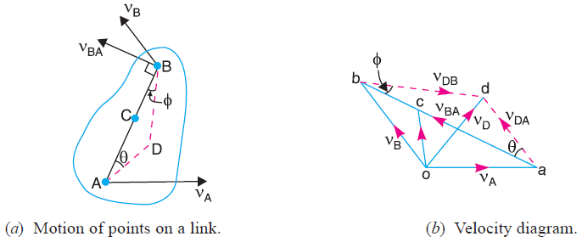
Theory of machines Wessam Al Azzawi
Mechanism:
Consider two points A and B on a link as shown in Fig.(a).
The absolute velocity of point v_{A} is known in magnitude
The absolute velocity of v_{B} is known in direction only.
The velocity of B may be determined by drawing the velocity diagram Fig. (b).
The velocity diagram is drawn as follows :

Slide 21
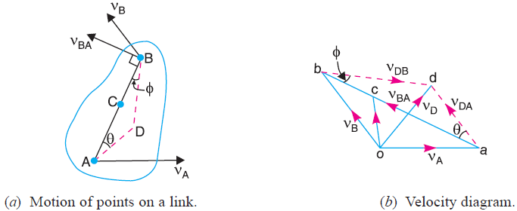
Theory of machines Wessam Al Azzawi
Mechanism:
Take some convenient point o, known as the pole
Through o, draw oa parallel and equal to v_{A}, to some suitable scale
Through a, draw a line perpendicular to AB of Fig.(a). This line will represent the velocity of B with respect to A, i.e. v_{BA}
Through o, draw a line parallel to v_{B} intersecting the line of v_{BA} at b
Measure ob, which gives the required velocity of point B ( v_{B}), to the scale

Slide 22
Theory of machines Wessam Al Azzawi
Mechanism:
The absolute velocity of any point C on AB may be determined by dividing vector ab at c in the same ratio as C divides AB in Fig.
The vector oc represents the absolute velocity of point C (v_{C}) and the vector ac represents the velocity of C with respect to A i.e. v_{CA}.
The absolute velocity of any other point D outside AB may also be obtained by completing the velocity triangle abd and similar to triangle ABD
The angular velocity of the link AB may be found by dividing the relative velocity of B with respect to A (v_{BA}) to the length of the link AB:

Slide 23
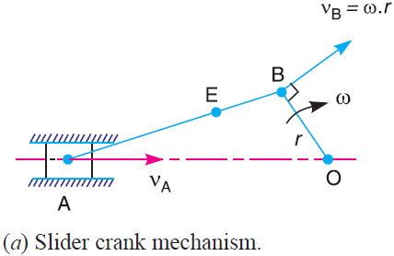
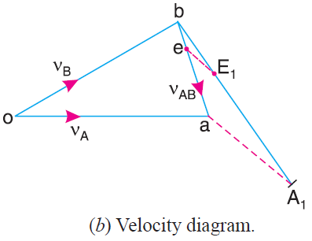
Theory of machines Wessam Al Azzawi
Mechanism:
Velocities in Slider Crank Mechanism
A slider crank mechanism is shown in Fig.a, slider A is attached to the connecting rod AB. Let the radius of crank OB be r and let it rotates in a clockwise direction, about the point O with uniform angular velocity ω rad/s. Therefore v_{B} is known in magnitude and direction. The slider reciprocates along the line of stroke AO. The velocity of the slider v_{A} may be determined by relative velocity method as:
From any point o, draw ob parallel to the direction of v_{B} (or perpendicular to OB) such that ob = vB = ω.r, to some suitable scale, as shown in Fig.b
Since AB is a rigid link, therefore the velocity of A relative to B is perpendicular to AB. Now draw vector ba perpendicular to AB to represent the velocity of A with respect to B i.e. v_{AB}.
From point o, draw vector oa parallel to the motion of the slider A (along AO only). The vectors ba and oa intersect at a. Now oa represents the velocity of the slider A i.e. v_{A}, to the scale.

Slide 24
Theory of machines Wessam Al Azzawi
Mechanism:
Velocities in Slider Crank Mechanism
Note: The absolute velocity of any other point E on the connecting rod AB may also be found out by dividing vector ba such that be/ba = BE/BA

Slide 25
Theory of machines Wessam Al Azzawi
Mechanism:

Slide 26
Theory of machines Wessam Al Azzawi
Mechanism:

Slide 27
Theory of machines Wessam Al Azzawi
Mechanism:
The crank and connecting rod of a theoretical steam engine are 0.5 m and 2 m long respectively. The crank makes 180 r.p.m. in the clockwise direction. When it has turned 45° from the inner dead centre position, determine : 1. velocity of piston, 2. angular velocity of connecting rod, 3. velocity of point E on the connecting rod 1.5 m from the gudgeon pin.

Slide 28
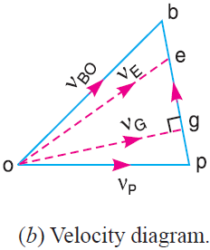
Theory of machines Wessam Al Azzawi
Mechanism:

Slide 29
Theory of machines Wessam Al Azzawi
Mechanism:

Slide 30
Theory of machines Wessam Al Azzawi
Mechanism:

Slide 31
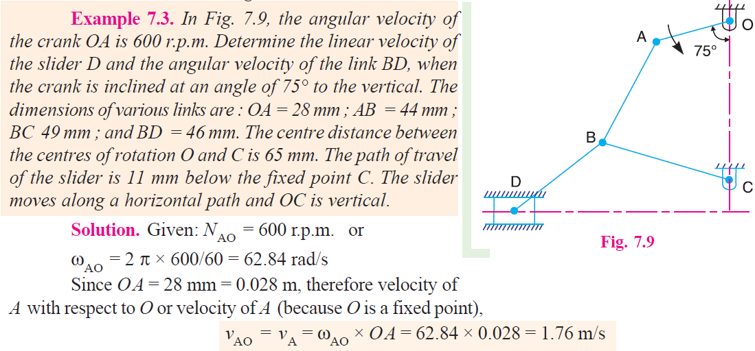
Theory of machines Wessam Al Azzawi
Mechanism:

Slide 32
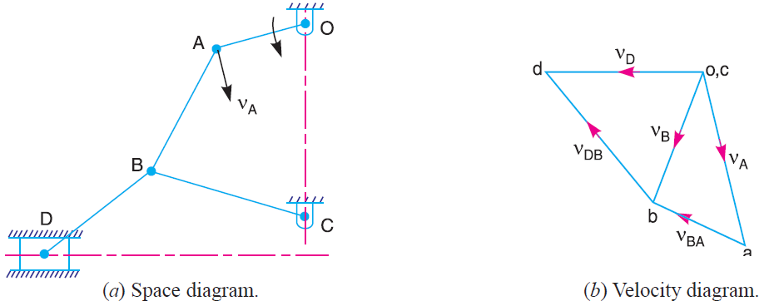
Theory of machines Wessam Al Azzawi
Mechanism:

Slide 33
Theory of machines Wessam Al Azzawi
Mechanism:

Slide 34
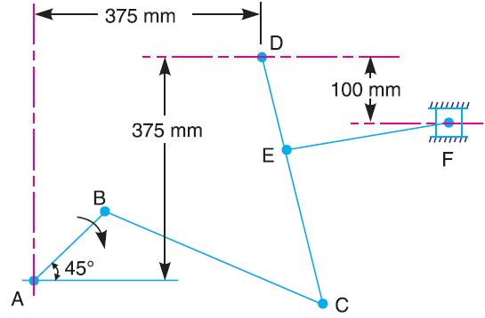
Theory of machines Wessam Al Azzawi
Mechanism:
Example: The mechanism, as shown in Fig. 7.11, has the dimensions of various links as follows : AB = DE = 150 mm ; BC = CD = 450 mm ; EF = 375 mm.
The crank AB makes an angle of 45° with the horizontal and rotates about A in the clockwise direction at a uniform speed of 120 r.p.m. The lever DC oscillates about the fixed point D, which is connected to AB by the coupler BC. The block F moves in the horizontal guides, being driven by the link EF. Determine: 1. velocity of the block F, 2. angular velocity of DC

Slide 35
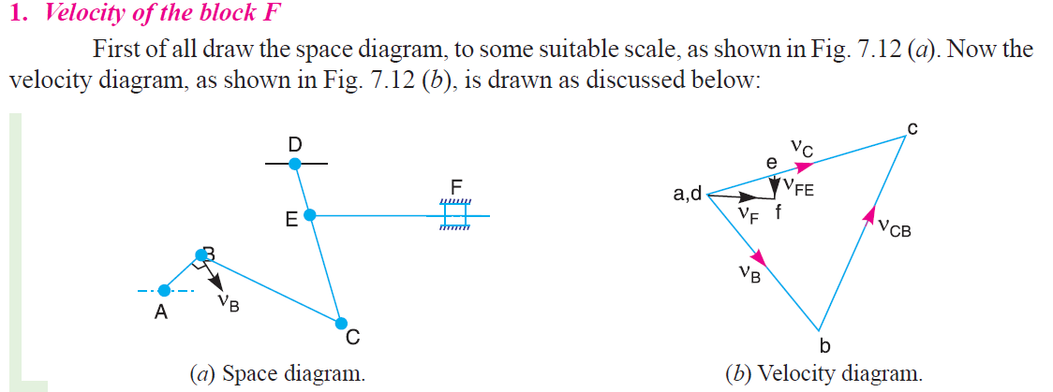
Theory of machines Wessam Al Azzawi
Mechanism:

Slide 36
Theory of machines Wessam Al Azzawi
Mechanism:

Slide 37
Theory of machines Wessam Al Azzawi
Mechanism:

